Slide 1
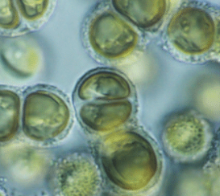
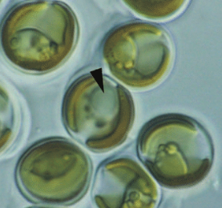
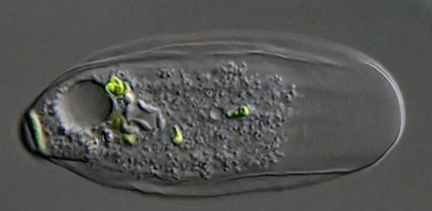
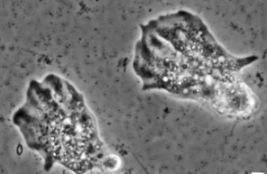
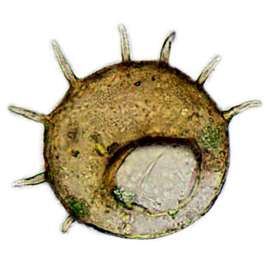
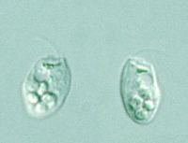
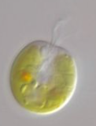
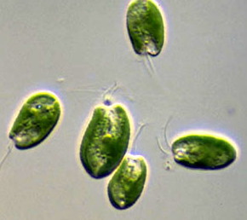
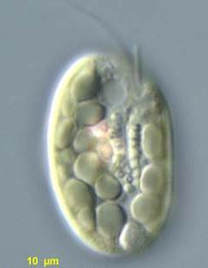
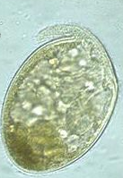
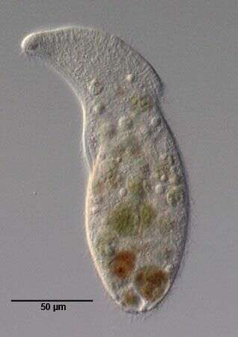
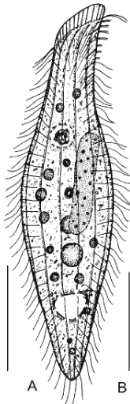
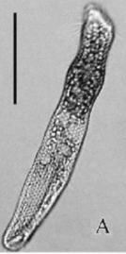
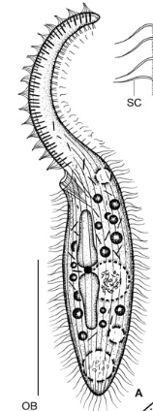
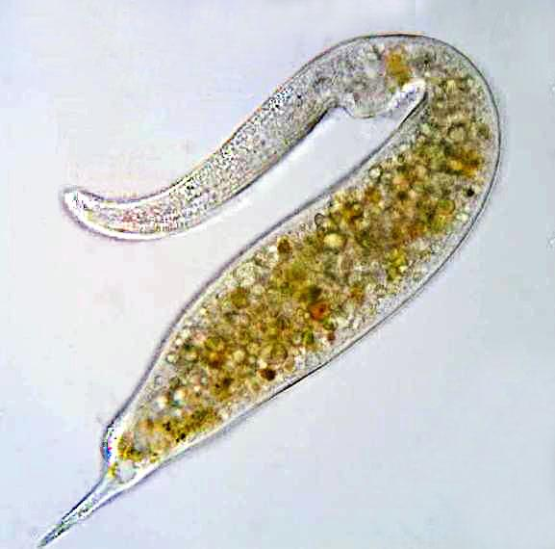
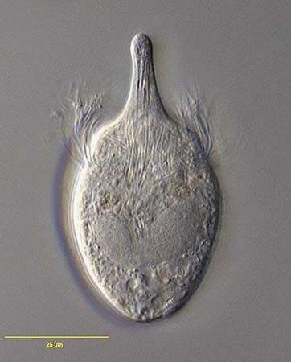
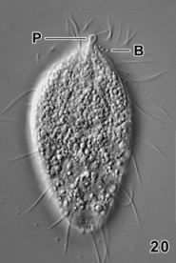
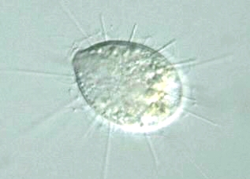
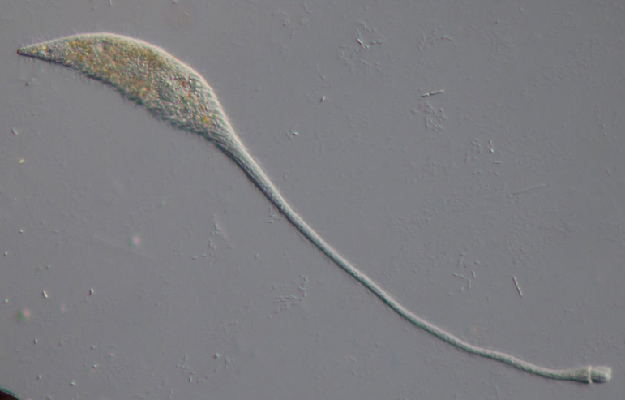
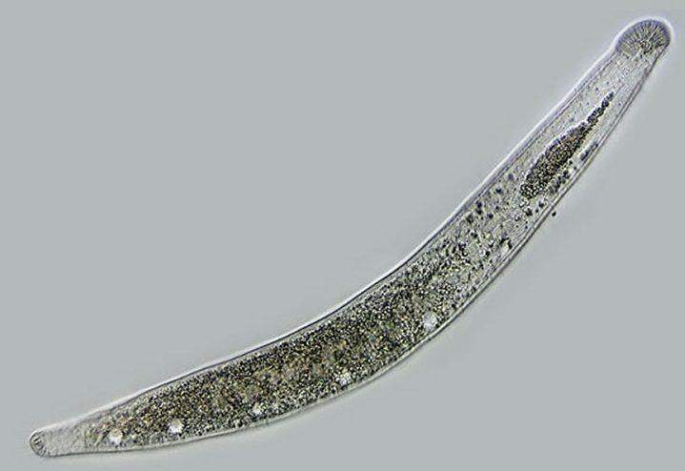
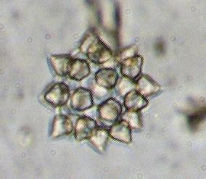
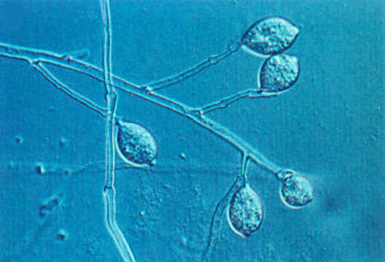
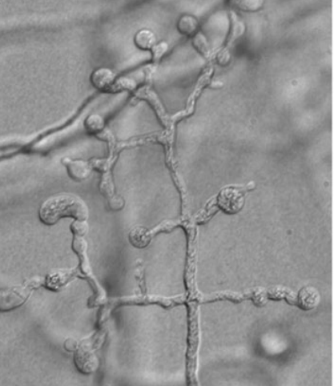
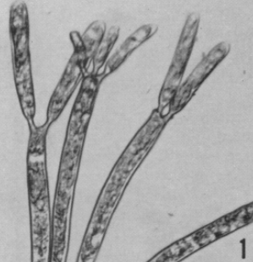
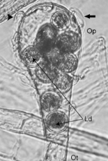
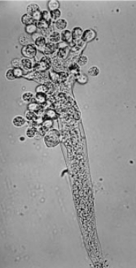
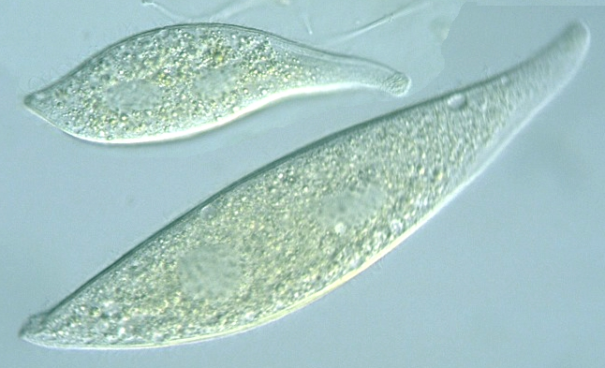
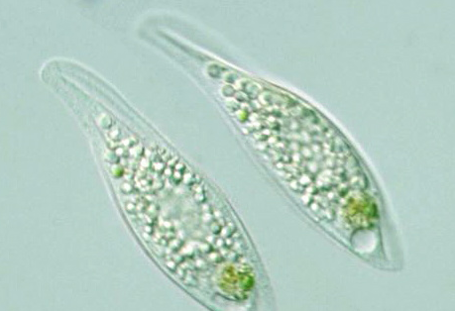
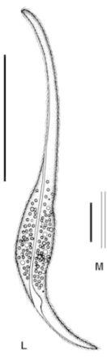
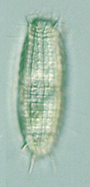
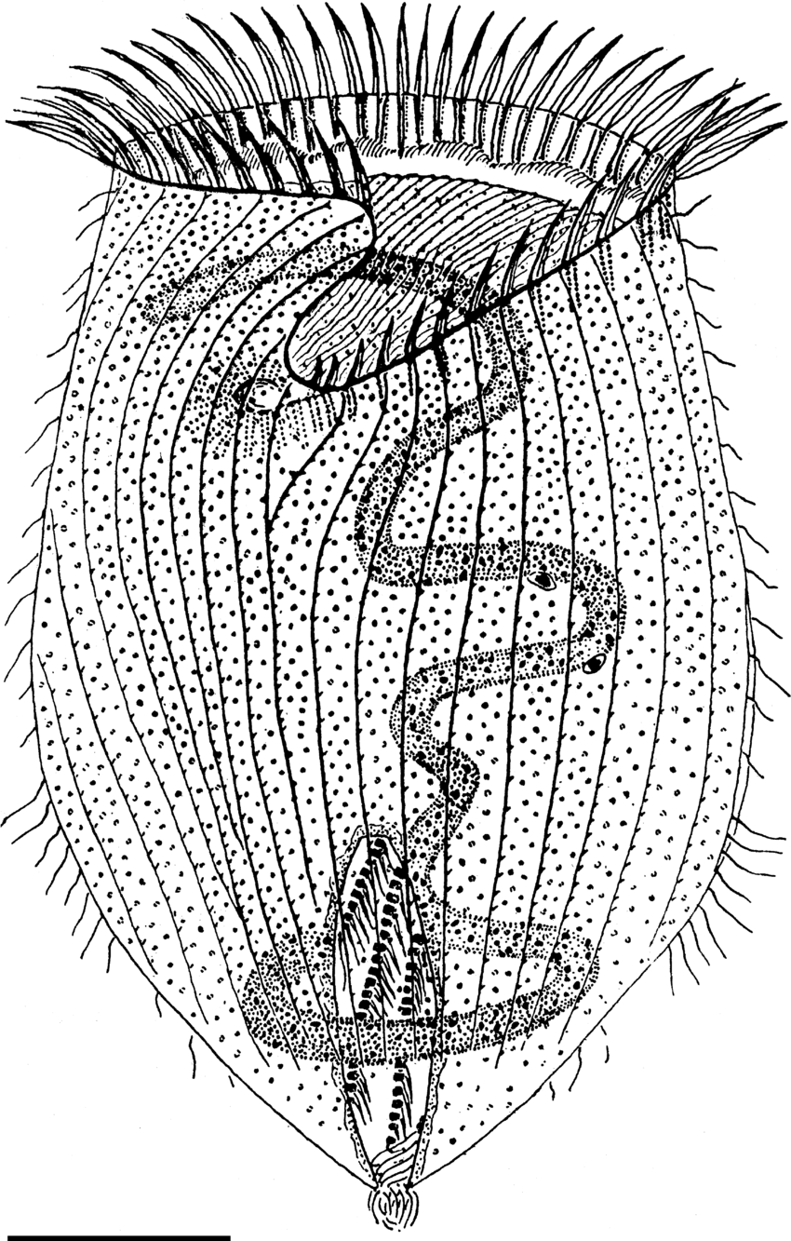
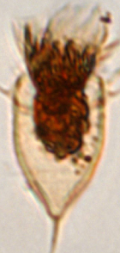
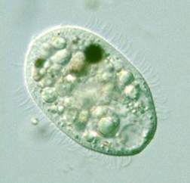
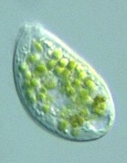
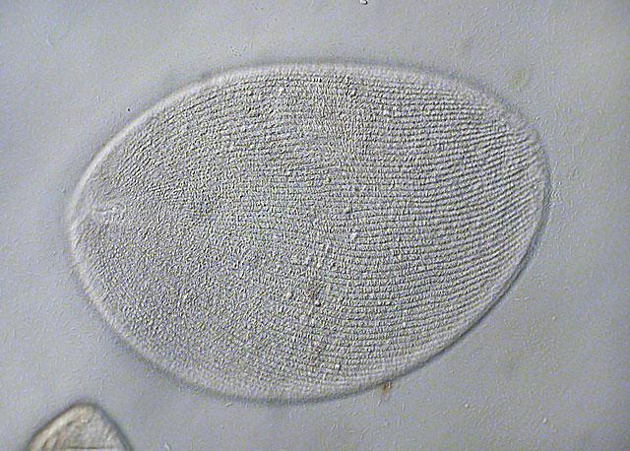
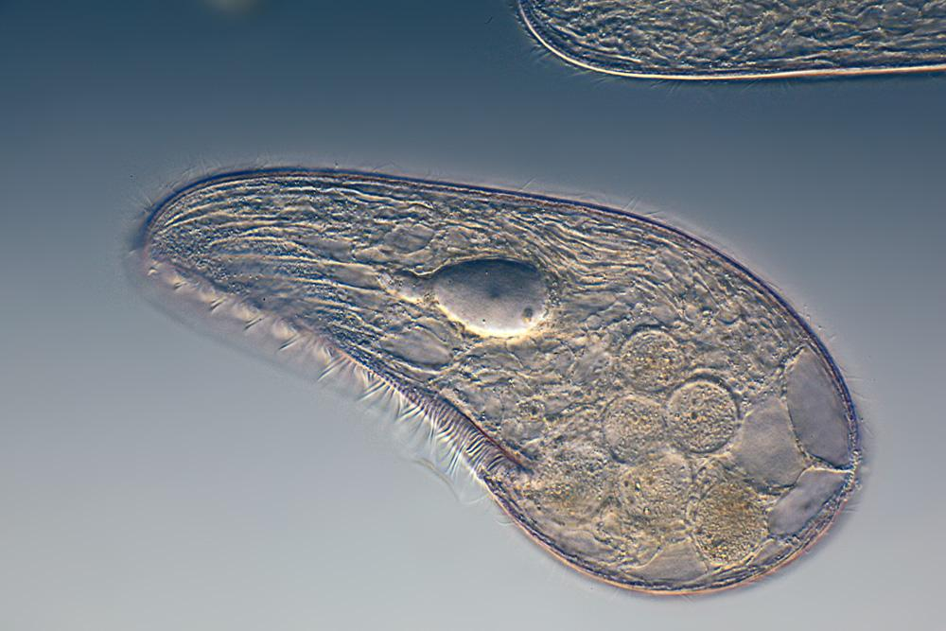
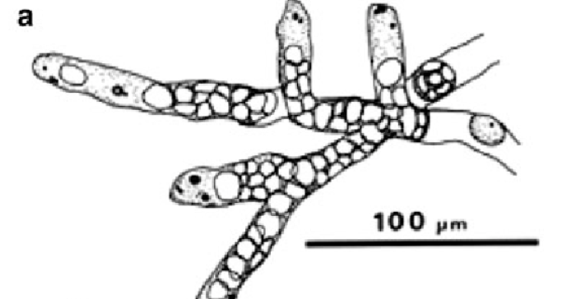
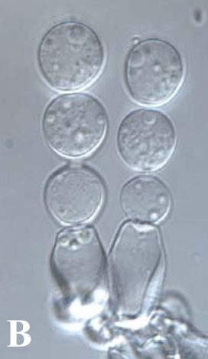
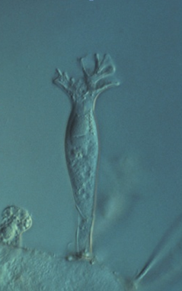
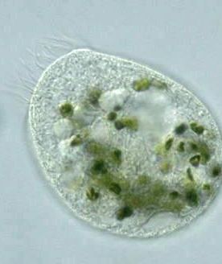
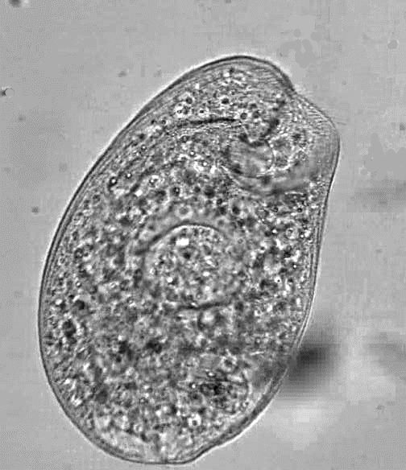
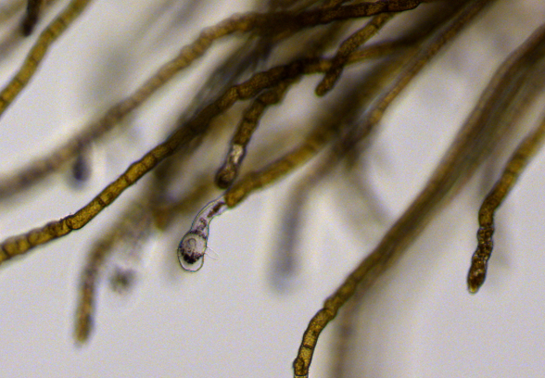
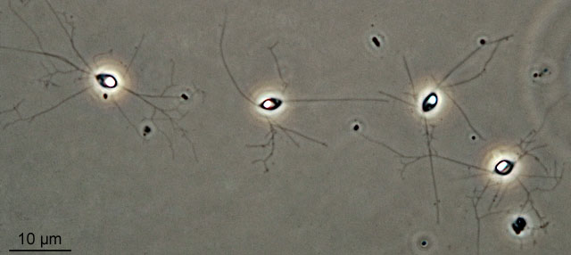
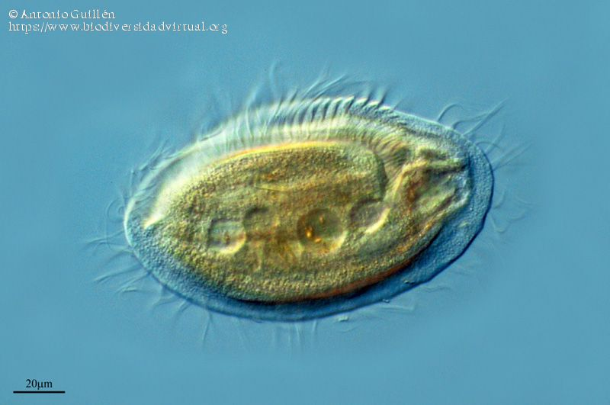
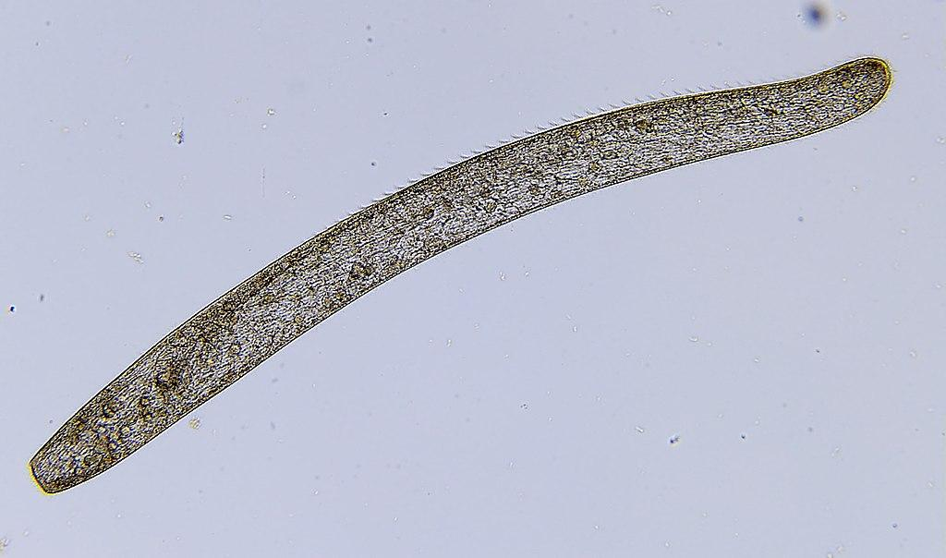
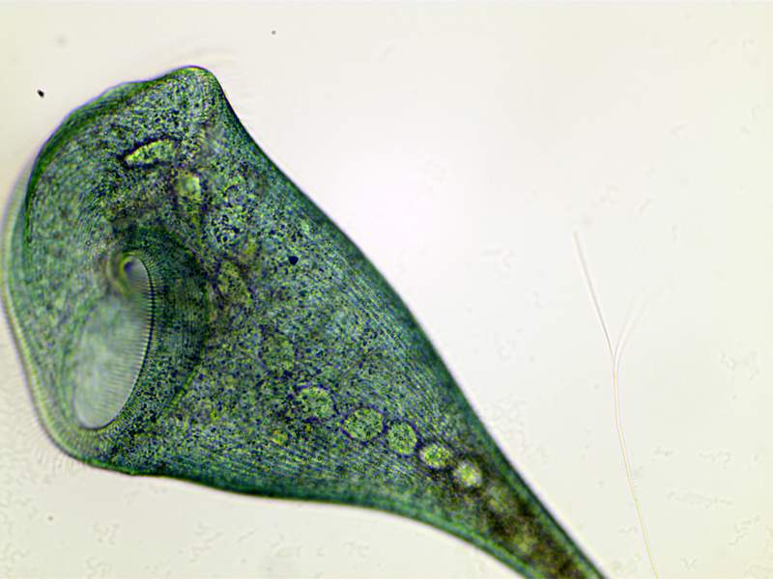
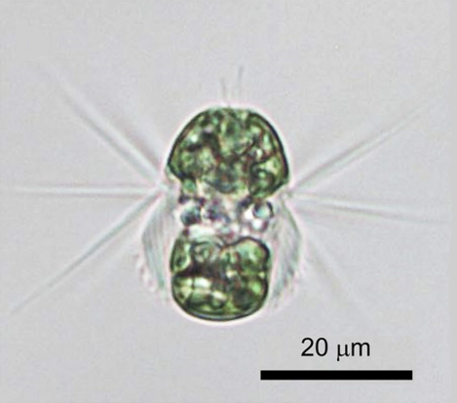
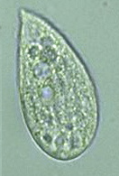
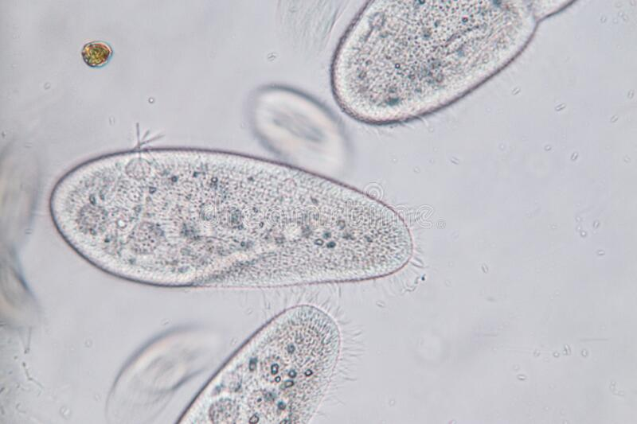
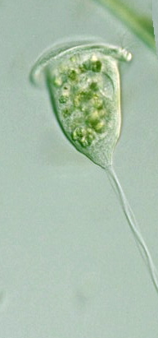











































































































































































Dactylopodida
142
Angulamoeba
Endostelium
141
Arboramoeba
156
Mycamoeba
155
Pellitidae
140
Cavosteliida
154
Brevimastigomonas
195
139
Darbyshirella
153
Cavernomonas
Flabellinia
Trichosidae
138
Dictyamoeba
152
100
Himatismenida
Vannellidae
137
Filamoeba
151
Cercomonas
194
M
Centramoebida
Eocercomonas
Longamoebia
136
Flamellidae
150
Cercomonadidae
Neocercomonas
100
Dermamoebida
Fractovitellida
193
Stygamoebida
135
149
Cercomonadida
Heteromitidae
Nucleocercomonas
M
Thecamoebida
100
192
134
Heliamoeba
148
Centropyxidae
164
Chlorarachniophyceae
Paracercomonas
Discosea
Archamoeba
Mastigamoebida
133
Holomastigida
191
Amoebozoa
147
Cylindriflugiidae
163
Phytocercomonas
Evosea
Cutosea
M
Pelobiontida
Ischnamoeba
Clautriavia
190
132
Difflugiidae
Glissomonadida
Clathrulinidae
Phalansterium
185
Tubulinea
Eumycetozoa
Rhizomastix
146
100
Variosea
130
131
Protosteliida
145
Hyalospheniidae
M
Granofilosea
Limnofila
184
Corycida
Difflugina
Lesquereusiidae
M
Imbricatea
Massisteriidae
129
Plagiopyxidae
Kraken
Mesofilidae
183
Echinamoebida
Arcellinida
Heleoperidae
Arcellidae
Elardia
128
Phryganellina
144
Netzeliidae
Leptogromia
Discomonas
Euamoebida
M
Aquavolonida
100
Limnofilidae
Marimonadida
Leptomyxida
M
Sphaerothecina
Pyxidicula
162
Cercozoa
Reticulamoeba
Metromonadea
v
M
v
176
Amoebidae
Trigonopyxidae
Rhizaria
Endomyxa
Sainouroidea
Nudifila
182
Euglyphida
Amoeba
161
Thecofilosea
v
165
Retaria
Silicofilosea
Thaumatomonadida
Hartmanellidae
Chaos
v
160
v
Acetospora
Spongomonadida
Tubulinida
181
Guttulinopsis
188
143
Deuteramoeba
159
Glaeseria
v
Filoreta
Guttulinopsidae
Rosculus
157
v
Gromiida
175
Helkesimastigidae
Hartmannella
157
100
M
v
Phytomyxea
Homocognata
Nolandella
Vampyrellida
Olivorum
180
Polychaos
158
M
Sainouridae
v
Acantharea
Ptolemeba
157
M
v
Foraminifera
Cryomonadida
Saccamoeba
157
v
Polycystinea
Ebriacea
M
M
Phaeodarea
M
Sticholonchida
Tectofilosida
M
Ventricleftida
Hyalodiscidae
179
Leptophryidae
178
M
Placopodidae
Foraminifera
Allogromida
208
M
Sericomyxidae
Ammodiscus
M
M
Carterinida
M
Cyclammina
M
Ellipsolagenidae
Globothalamea
M
M
Lagenina
Baffinellaceae
Chilomonas
127
M
Cryptomonadaceae
M
Lituolida
Cryptochloris
Miliolida
Cryptomonas
M
Hemiselmidaceae
126
Cryptomonadales
124
Monothalamids
207
Goniomonadaceae
M
Cryptophyta
Cyathomonadacea
M
123
Plagiomonas
Rotaliida
206
Hemiarma
M
Pyrenomonadales
Chroomonadaceae
Plagioselmis
Chroomonas
125
M
M
Rzehakinidae
Urgorri
M
Geminigeraceae
Falcomonas
M
M
M
Spirillinida
Pyromonadaceae
Komma
M
M
Textulariida
M
Xenophyophorea
123
124
125
69
70
71
72
73
74
75
76
77
78
79
85
Cyclotrichida
Acropisthiidae
M
83
Armophorea
51
84
82
80
37
Haptorida
Actinobolinidae
79
81
Bicosoecidae
Colpodea
36
Haptoria
Pleurostomatida
Amphileptidae
67
Apertospathulidae
78
93
Litostomatea
Didiniidae
Trichostomatia
Litonotidae
77
M
66
Caecitellus
66
64
Muranotrichea
M
Dileptidae
Actinophrys
Protolitonotidae
65
76
91
M
Apostomatida
Actinophryidae
Actinosphaeria
Cafeteriaceae
65
Nassophorea
35
Dimacrocaryonidae
75
90
M
67
Bicosoecida
Cafileria
Odontostomatea
Astomatida
M
Bigyra
Labyrinthulomycetes
34
Enchelyidae
89
E
Nanomonadea
Nanos
M
Opalozoa
M
Oligohymenophora
Hymenostomatida
50
Helicoprorodontidae
M
Chrysomerophyceae
Siluaniidae
Opalinata
92
61
62
63
Parablepharismea
33
Peniculida
Homalozoonidae
M
Pseudophyllomitidae
49
74
M
M
Developea
Phyllopharyngea
Balanionidae
Lacrymariidae
Placidida
M / E
Peritrichia
73
Hypochytridiomycetes
59
48
Colepidae
64
Paraspathidiidae
Stramenopila
M
Plagiopylea
32
Scuticociliatia
72
Pirsoniales
47
M
Oomycota
Albuginales
Apicomplexa
Prostomatea
Chonotrichia
Halodinium
Pseudoholophryidae
71
88
46
M
60
Intramacronucleata
Spirotrichea
Hexasterias
M
Ochrophyta
Anisolpidiales
87
58
Ciliophora
Phyllopharyngia
Pseudotrachelocercidae
45
Holophryiadae
Postciliodesmatophora
Heterotrichea
v
63
Spathidiidae
Lagenidiales
Alveolata
Colpodellida
Rhynchodia
M
70
86
56
44
Placidae
v
Tracheliidae
86
Leptomitales
85
Colponemida
M
Karyorelictea
Suctoria
Plagiocampidae
69
43
62
55
57
Alphamonaceae
v
Trachelophyllidae
Myzocytiopsidales
31
68
M
Dinophyceae
Foissnerophrys
M
29
42
Prorodontidae
v
Trachelotractus
Chromeraceae
M
Olpidiopsidales
M
M
Perkinsozoa
M
Prorodontida
Urotrichidae
Peronosporales
Colpodellaceae
30
Prostomatida
Choreotrichida
61
88
84
M
M
60
Pythiales
Vitrellaceae
Choreotrichia
Tintinnida
83
60
Rhipidiales
Hypotrichia
82
53
52
41
Blepharismidae
59
Saprolegniales
81
Oligotrichia
Sclerosporales
54
51
49
40
M
Chattoniidae
87
89
80
50
Protocruziida
58
Chromulinaceae
Stichotrichia
Climacostomidae
Chrysoamoebidaceae
Anthophysa
122
39
57
113
Chromulina
121
48
47
Heterotrichida
Condylostomatidae
56
Licnophorida
E
Chrysocapsaceae
112
Chromulinospumella
M
Fabreidae
100
Loxodida
Folliculinidae
Bacillariophyta
95
Apoikiaceae
100
Chrysolepidomonadaceae
Chrysonephele
38
55
112
44
M
M
Protoheterotrichida
Peritromidae
M
Bolidophyceae
Chromulinales
Dinobryaceae
111
Chrysoxys
43
Protostomatida
Phacodinium
Chrysophyceae
Chrysosphaerales
Oikomonadaceae
M
54
Ochrophyta
100
Cyclonexis
120
46
Spirostomidae
Paraphysomonadaceae
53
Dictyochophyceae
Hibberdiales
110
M
Monas
Stentoridae
52
Acrasida
Eustigmatophyceae
Hydrurales
101
Phaeoplacaceae
109
Ochromonas
Acrasidae
25
M
119
41
v
E
Olisthodiscophyceae
Phaeothamnales
Diplonemidae
Fumarolamoeba
M
Pedospumella
M
100
M
Segregatospumella
Metakinetoplastina
Barbeliidae
M
Pelagophyceae
40
Heteramoeba
M
100
Spumella
100
45
Euglenida
18
19
Gruberellidae
Naegleria
Aurearenophyceae
42
Picophagaceae
M
24
M
Uroglena
118
Kinetoplastea
Prokinetoplastina
v
28
M
Parafumarolamoeba
M
Chrysoparadoxa
Aurem
27
Pinguiophyceae
Euglenozoa
M
M
Percolomonadidae
Symbiontida
23
Uroglenopsis
117
v
Paravahlkampfia
PX clade
Phaeophyceae
M
Discoba
Heterolobosea
Creneidae
Psalteriomonadidae
27
Raphidophyceae
Botrydiales
108
Urostipulosphaera
M
22
Tetramitus
94
Phaeosacciophyceae
116
39
27
99
Jakobida
Andalucina
M
Pharyngomonada
Stephanopogonidae
Mischococcales
21
Vahlkampfia
M
Phaeothamniophyceae
107
26
Synchromophyceae
98
Tsukubamonadida
Histionina
17
Schizopyrenida
Eutetramitia
Vahlkampfiidae
Willaertia
M
E
Synurophyceae
Schizocladia
Tribonematales
Ophirina
106
Tetramitia
M
Xanthophyceae
Vaucheriales
38
Neovahlkampfiidae
28
105
M
Selenaionidae
Dactylomonas
Heterogloeales
Acrispumella
Tulamoebidae
20
97
100
36
34
32
31
30
Selenaion
Ochromonadales
Ochromonadaceae
M
104
35
29
Rhizochloridales
Mallomonadaceae
Mallomonas
37
Synurales
96
Neotessellaceae
103
Synura
114
115
Gloeochaetales
33
11
Apusomonas
Synuraceae
Glaucocystales
7
92
102
10
Amastigomonas
Cyanophoraceae
Chelonemonas
9
Multimonas
6
25
24
90
91
Land plants
3
27
26
94
12
Hatena
Streptophyte algae
Thecamonas
95
Chlorophyte algae
23
97
Katablepharis
Katablepharidaceae
8
Breviata
20
13
Leucocryptos
M
Roombia
Ancoracysta
Apusomonadidae
Lenisia
6
21
Picomonadea
M
93
96
14
Pygsuia
Metazoa
Acanthoecida
22
M
5
Subulatomonas
Choanoflagellata
Craspedida
101
Meringosphaera
M
4
19
18
98
99
15
Panacanthocystida
M
Filasterea
Pterocystida
Ichtyospora
17
16
100
106
102
Spiculophrys
M
Fungi
14
13
12
103
104
105
107
M
Imasidae
15
11
10
113
3
114
115
Malawimonadidae
9
8
7
6
110
111
Spironemidae
108
109
112
122
1
3
2
116
117
118
119
120
121
5 μm 20 μm 80 μm
5
4
1

